Slide 1

Install python and jupyter notebook

Slide 2
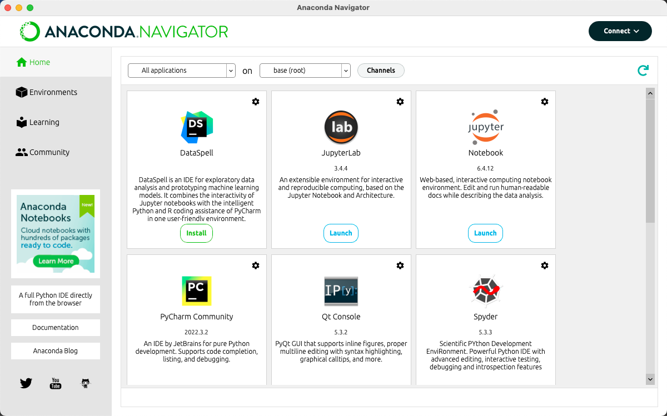
Anaconda

Slide 3
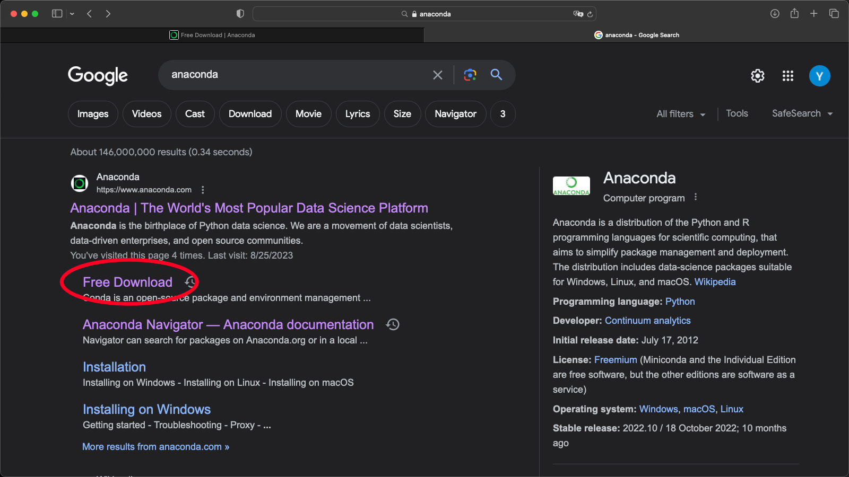
Anaconda

Slide 4
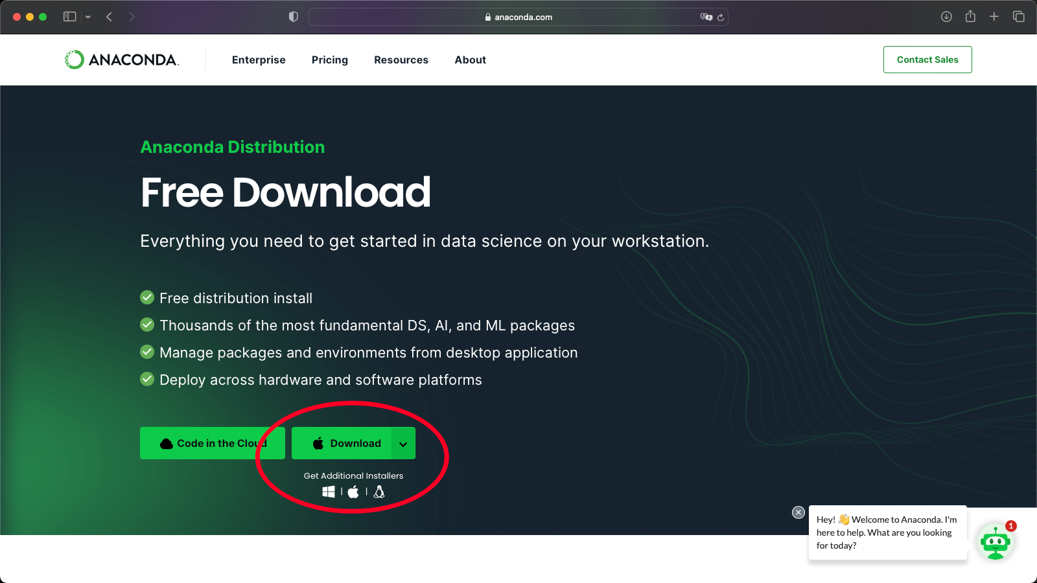
Anaconda

Slide 5
Anaconda Installation Help
https://docs.anaconda.com/free/anaconda/install/index.html

Slide 6
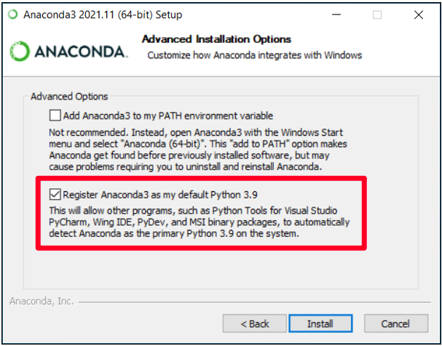
For Windows

Slide 7
Package Managers (like pip, conda)
Pip and Conda are both package managers for the respective Python Distributions.
Package managers are software tools that simplify the process of installing, updating, and managing software packages and their dependencies.
They provide a centralized repository of packages and handle the installation and configuration of those packages on your system.

Slide 8
2. Test if installation worked
Download lecture Jupyter notebooks from Canvas.
Test to see if you can run all cells.
If you are new to Python/jupyter/coding, take the remaining time in section to review the lecture notebooks.
Understand every line of code/how it works.
Try to replicate the given code from memory.
Ask your TA questions if you need help.

Slide 9
3. How to set up Virtual Environments
Helpful to have but not necessary

Slide 10
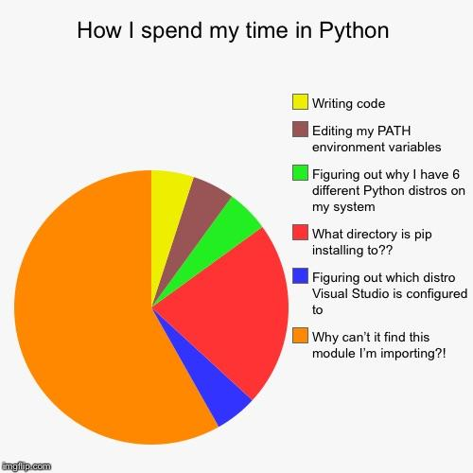

Slide 11
The solution: Virtual Environments!!!
A virtual environment provides a self-contained environment where you can install specific versions of Python packages and their dependencies without affecting the global Python installation or conflicting with other projects.

Slide 12
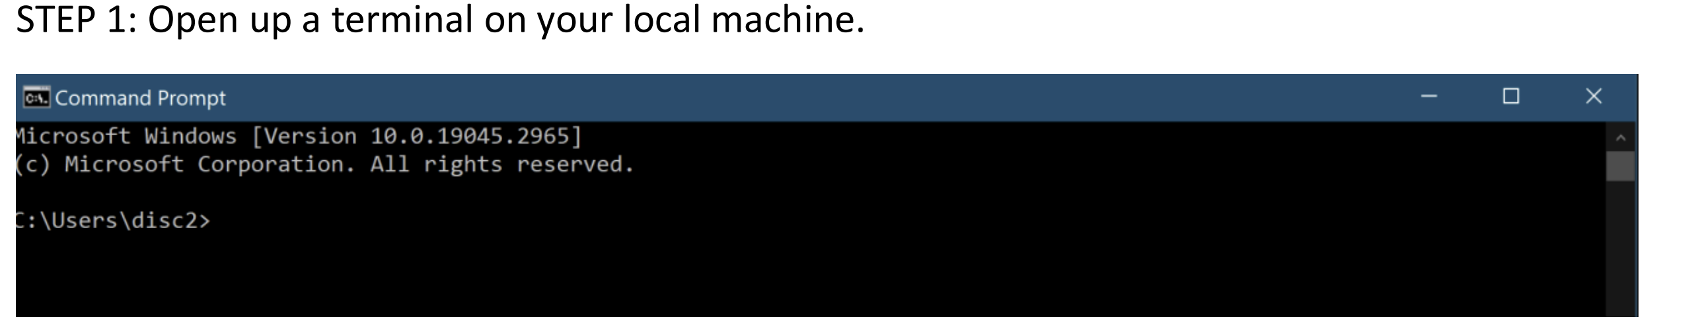
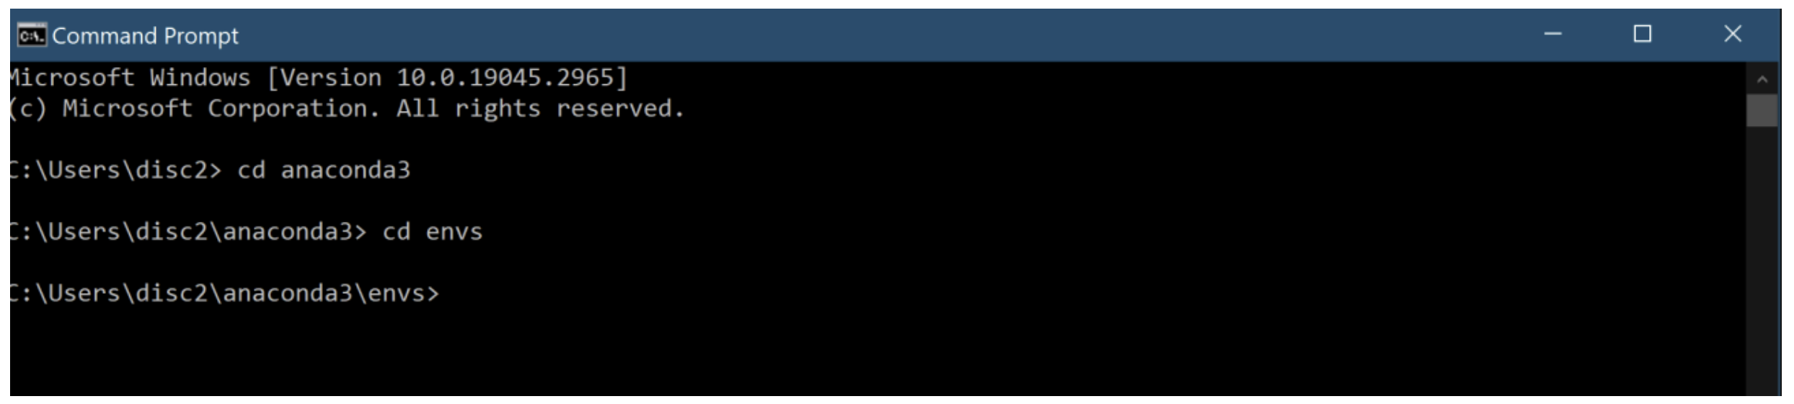
Let’s make one…

Slide 13
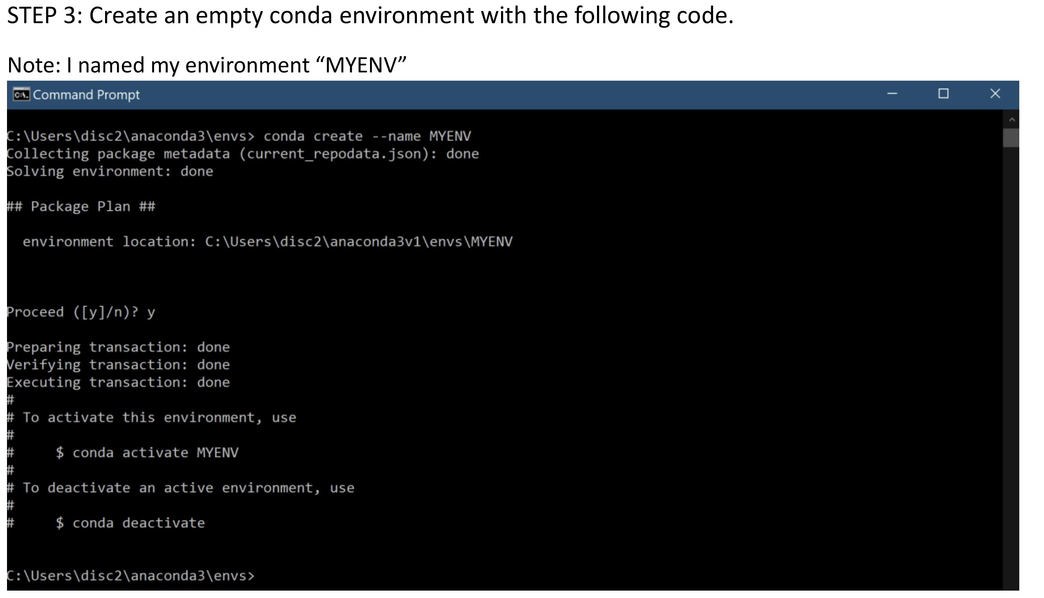

Slide 14
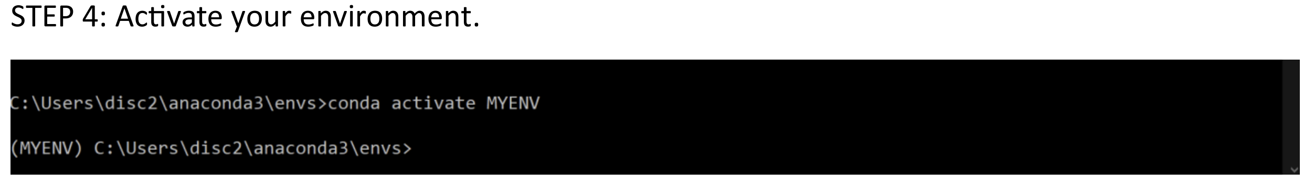
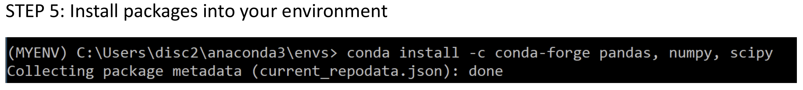

Slide 15
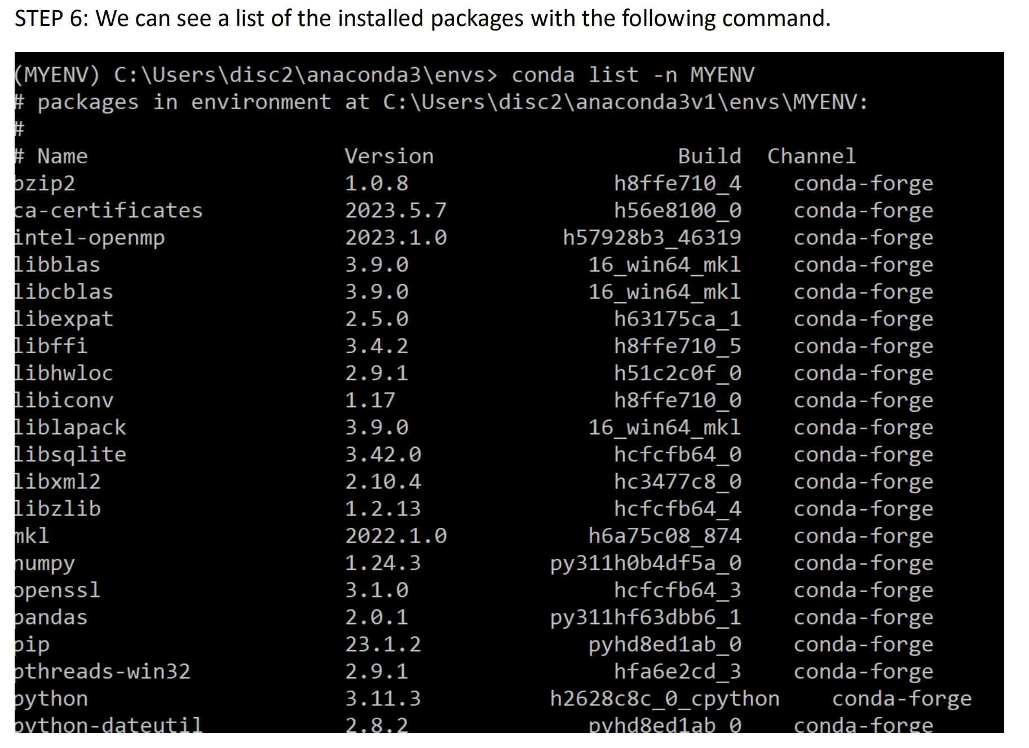

Slide 16
